Slide 1
Cross Sections
What you see when you slice.

Slide 2
What is a Cross Section?
So far we have dealt with two-dimensional figures and three-dimensional figures independently (more or less), but cross sections are where the two shall meet.
A cross section is the two-dimensional figure that results or that is revealed when a two-dimensional plane intersects with a three-dimensional figure.

Slide 3
Cross Section
Another way of saying it: a cross section is the shape you see on the inside when you slice off a piece of a figure.
Cutting an orange in half is a good example. When you slice the orange in half and then look at the new face you just made, what is its shape?
A circle.

Slide 4
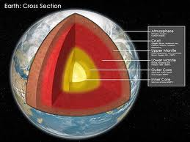
Cross Sections all Around
Cross Sections are all around us, everywhere.
There is a cross section when you cut your birthday cake.
There are cross sections in every loaf of sliced bread.
A floor plan of a house is nothing but a fancy cross section.
Science books and advertisements are full of them.

Slide 5
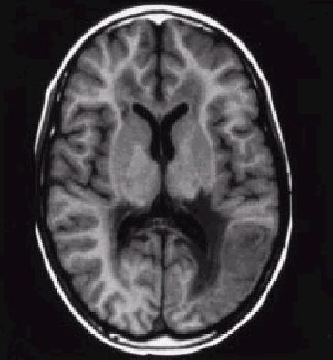
More Cross Sections
Cross sections let us see what is on the inside.
MRI images are good examples.
Mall maps are also examples.
Can you think of some examples of cross sections that you have seen and how or why they are used?

Slide 6
There’s more than One Way to slice a Figure.
There is an infinite number of ways that a two-dimensional plane can intersect with a three-dimensional figure. For this presentation, the following will be demonstrated:
Intersections Parallel with the base.
Intersections Perpendicular with the base.

Slide 7
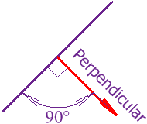
Clarifying Terms
An intersection perpendicular to the base will be exactly straight up and down have 90⁰ angles where the two-dimensional plane meets the three-dimensional base.
How do you remember what perpendicular is?

Slide 8
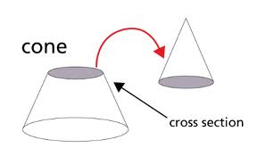
Clarifying Terms
An intersection parallel to the base is a side to side cut that is parallel to the base of the three-dimensional figure. It will always yield a two-dimensional figure in the shape of the base.
Remember: Parallel means that if the two-dimensional plane and the base of the figure went on forever, they would never, ever touch (intersect).
Let’s look at some cross sections.

Slide 9
A Cross Section Parallel to the base of a Cylinder gives us what two- dimensional shape?
A Circle

Slide 10
A Cross Section Perpendicular to the base of a Cylinder gives us what two- dimensional shape?
A Rectangle

Slide 11
A Cross Section Perpendicular to the base of a Pyramid gives us what two- dimensional shape?
A Triangle

Slide 12
A Cross Section Parallel to the base of a Square Pyramid gives us what two- dimensional shape?
A Square

Slide 13
A Cross Section Perpendicular to the base of a Rectangular Prism gives us what two- dimensional shape?
A Rectangle

Slide 14
A Cross Section Parallel to the base of a Rectangular Prism gives us what two- dimensional shape?
A Rectangle

Slide 15
A Cross Section Perpendicular to the base of a Cone gives us what two-dimensional shape?
A Triangle

Slide 16
A Cross Section Parallel to the base of a Cone gives us what two-dimensional shape?
A Circle

Slide 17
Finally, no matter how you slice it, the cross section of a sphere is going to be a ….
A Circle

